Slide 1
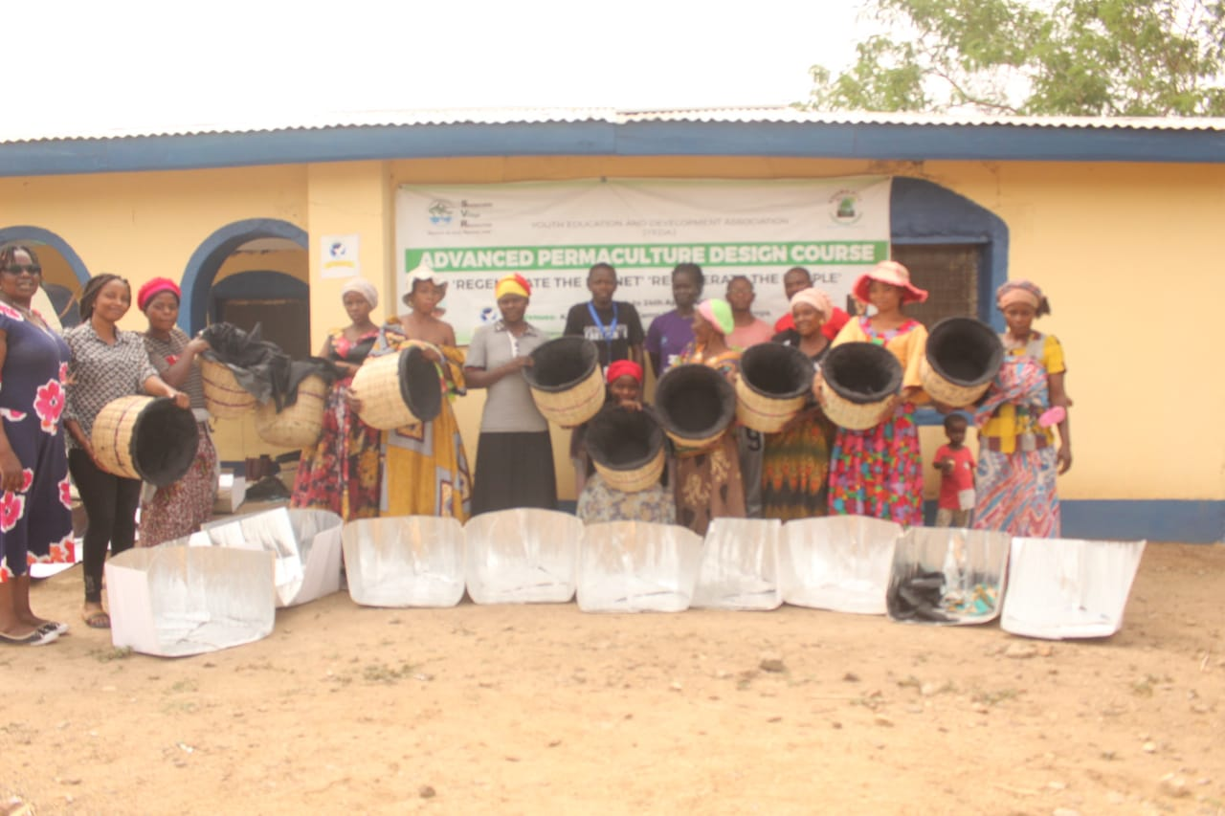
Focus Group
Haines Solar Cooker
&
Retained Heat Basket
10 Day Field Training
@ YEDA
May 23rd – June 1st 2022
Kakuma 3 Refugee Camp, Kenya
Notes:
The Haines 1 Pop Open Solar cooker focus group was held at the Youth Education Development Association (YEDA) in the Kakuma Refugee Camp in Kenya. The group of 11 women were selected based upon a short interview with 3 questions related to nterest in solar/basket cooking (integrated cooking solutions), money savings on charcoal and wood, and long-term (sustainable) solutions. The group assembled on the Saturday prior to the start of the workshop to get an overview of the workshop and review the daily commitment for the 10-day program.

Slide 2
Project Partners
Notes:
The Haines 1 pop open focus group project worked closely with the Youth Education Development Association (YEDA), Solar Household Energy (SHE), Haines Solar Cookers and the Solar Education Project; all groups with a common vision of providing quality, lasting, sustainable cooking solutions in the Kakuma Refugee Camp.
Photos, interviews and videos were captured by Khiuha Bruno. This group was able to problem solve and communicate in real time throughout the workshop to adjust and adapt to situations on the ground. A great deal was learned about the limitations of the area and region.

Slide 3
Growing Skilled Solar Cooks and Educators
Demonstrate and Solar Cook using the Haines 1 Pop Open Oven
Build a pool of trained instructors and facilitators in the Kakuma Camp (transfer knowledge)
Use the prepared training manual and workbook to ensure comprehensive and consistent training
Make and use the heat retention basket cooker
Follow up
Program Evaluation
Notes:
Assemble and cook with the Haines 1 pop open oven for 10 days (weather permitting), as a fossil fuel free alternative to current cooking methods. Share solar cooking recipes of high use foods such as ugali, rice, beans and breads. Cook with the concentrated sunlight and utilize the basket for heat retention and to continue slow cooking in the insulated basket (reduces the need for reheating foods or refrigeration).
The intent of the focus group was to gather data regarding the ease and use of the solar cookers after the workshop and the impact of solar cooker usage in the Kakuma Refugee Camp #3, Turkana region. Upon workshop completion, each of the 11 trainees received a certificate which indicates certification of completion of the materials presented; both through the education and background theory of how and why solar cookers work.

Slide 4
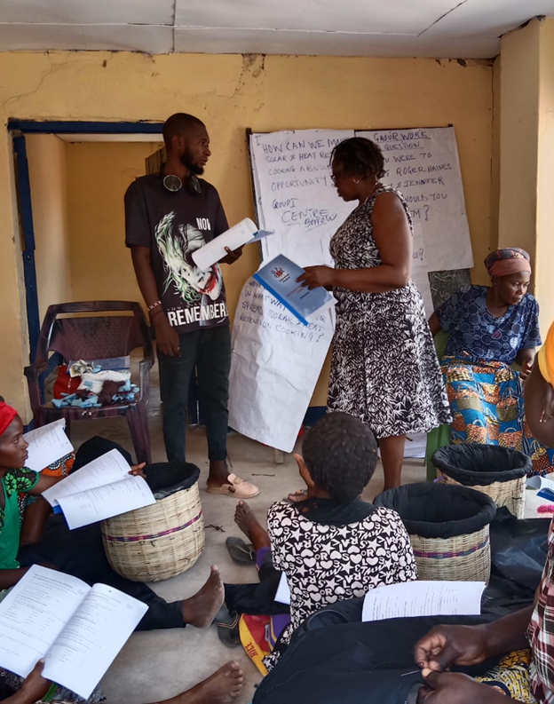
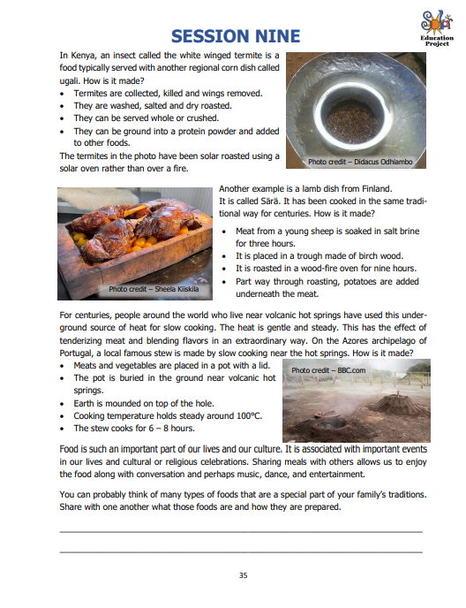
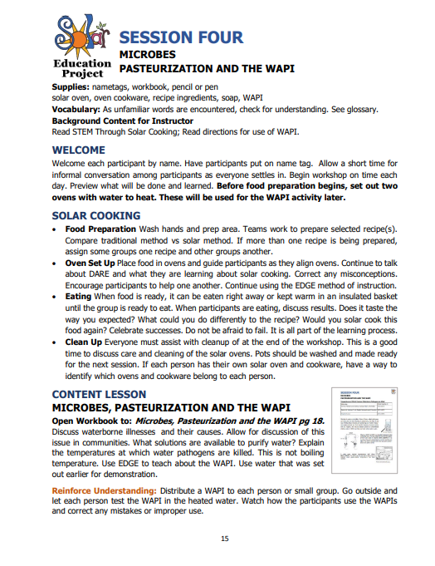
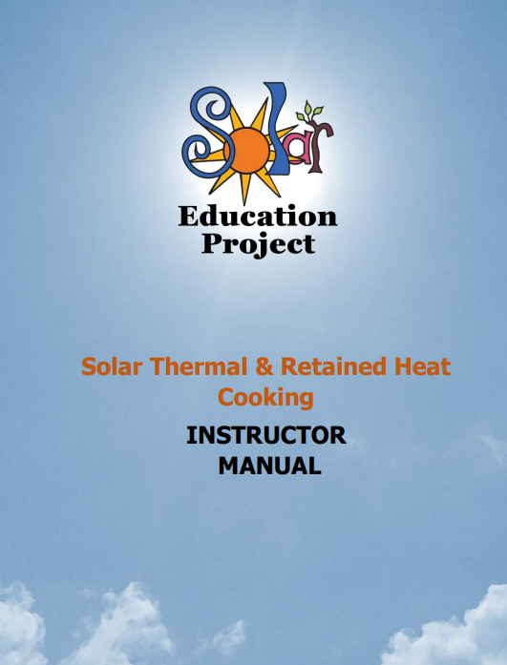
Field Manual and Trainee Workbook
Notes:
Solar Education Project developed a custom Facilitator Manual (Field Training Manual) and Trainee Handbooks (English version). The Manual provided resource materials and instructional techniques for the Facilitator to reference, as a well-rounded solar cooking and heat retention basket cooking program. Pre and post surveys Whats App Support Group is being used to increase data collection and provide trainee support for 3 months. The resource book was developed with input from several interested in trainee education and field training experiences.

Slide 5
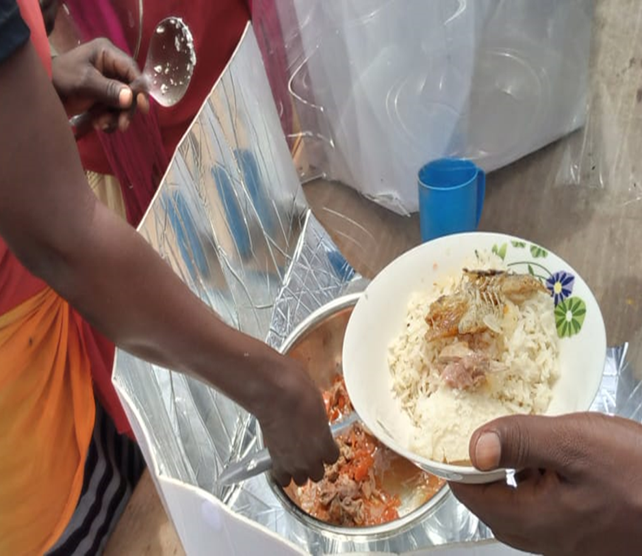
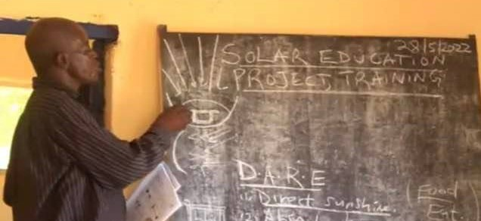
Learn to Solar Cook Using the D.A.R.E. Method
Direct Use one or more reflective surfaces to direct extra sunlight onto the cooking area. The more reflective area, the more light energy you will capture.
Absorb Use the color black to absorb all the wavelengths of visible light and transform the light energy to heat energy. The interior of the oven can be black. The cooking pot can be black.
Retain the heat inside the cooking space by trapping it. Use pyrex bowl enclosures, oven bags, lids, and insulation. By retaining the heat, you can cook food!
Eat healthy and nutritious food cooked with the cleanest fuel there is. Enjoy and Educate others!
Notes:
The Haines 1 pop open template was used to make the pop open ovens, after they group successfully made the Haines 1 Original oven. There were adequate material to make both. The Pop Open Oven was the unit used to cook from Day 2 onward, in addition with the basket cooker (days 8,9 and 10) for low sun days. The group spent 10 days, 6 solar cooking and 4 basket making and cooking (integrated cooking solutions). This combination of cooking solutions are designed to provide solutions for all weather conditions.
The Field Training Manual ensured a consistent and measured approach to field training. The Facilitatator guided the trainees through the subject content to the extent possible, using the workbook to illustrate concepts.

Slide 6
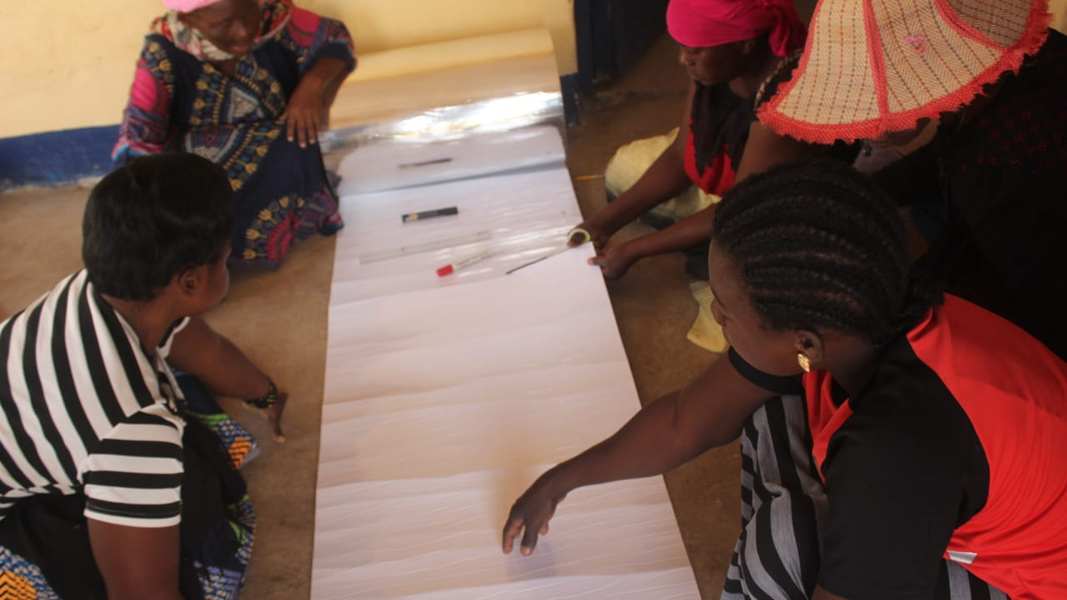
Haines Pop Open Oven
Template
MPET Roll
Polycarbonate sleeve and wind disc
Pop Open Dimensions 140 x 70cm
Black Pot with Lid
Notes:
The materials were generously donated by Roger Haines for distribution to the trainees. The Haines ovens have proven light weight, easy to store and use for cooking a wide variety of foods. The group spent 7 days in training with Camily R from Eldoret, a box oven manufacturer and Haines Oven trainee.

Slide 7
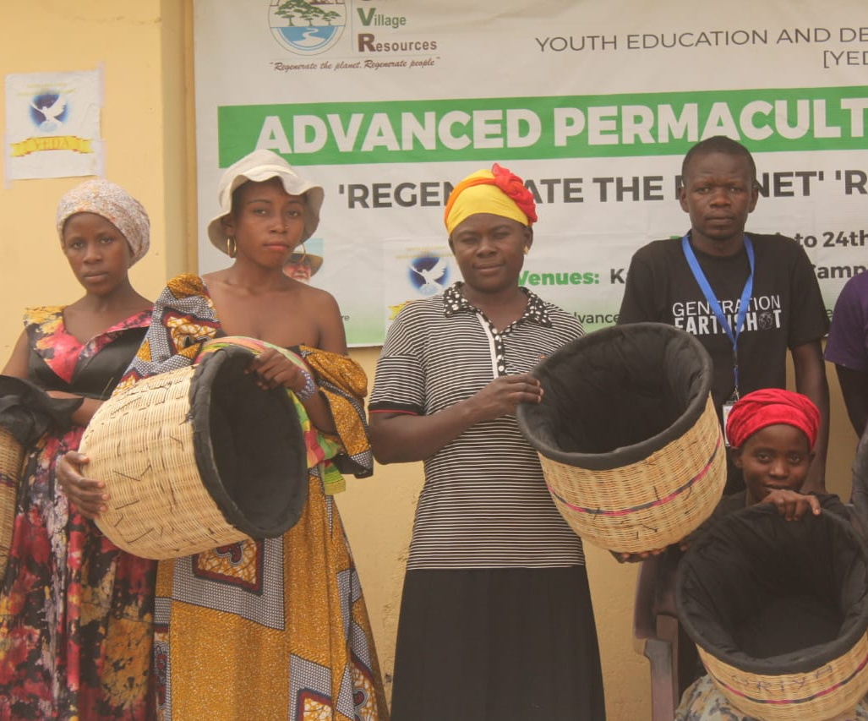
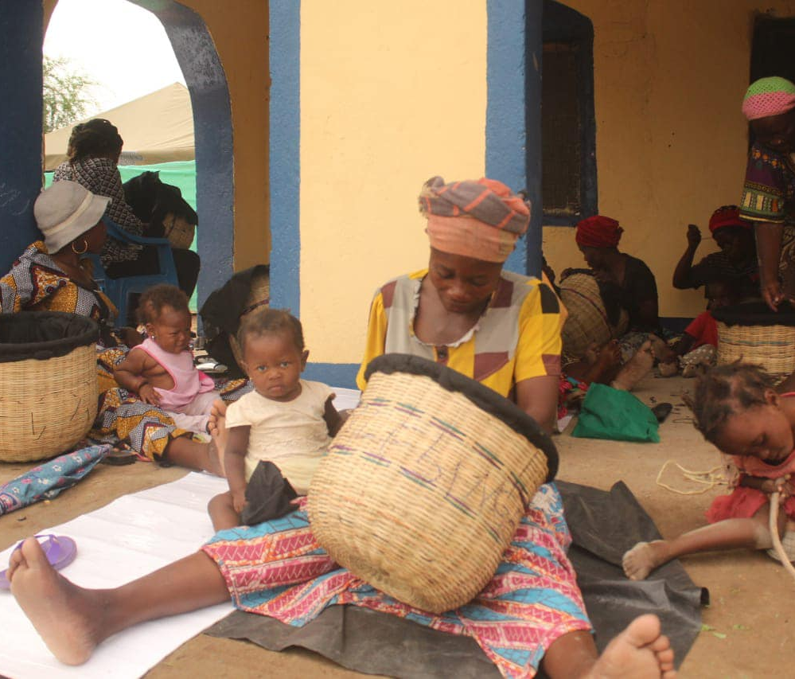
Heat Retention Basket Cooker
Notes:
All workshop participants were provided with all the materials necessary to make Heat Retention Baskets. Women were taught how to make the baskets This provides opportunity for Integrated Cooking options.. Baskets can be used for continued cooking and for keeping solar cooked foods warm until ready to eat.

Slide 8
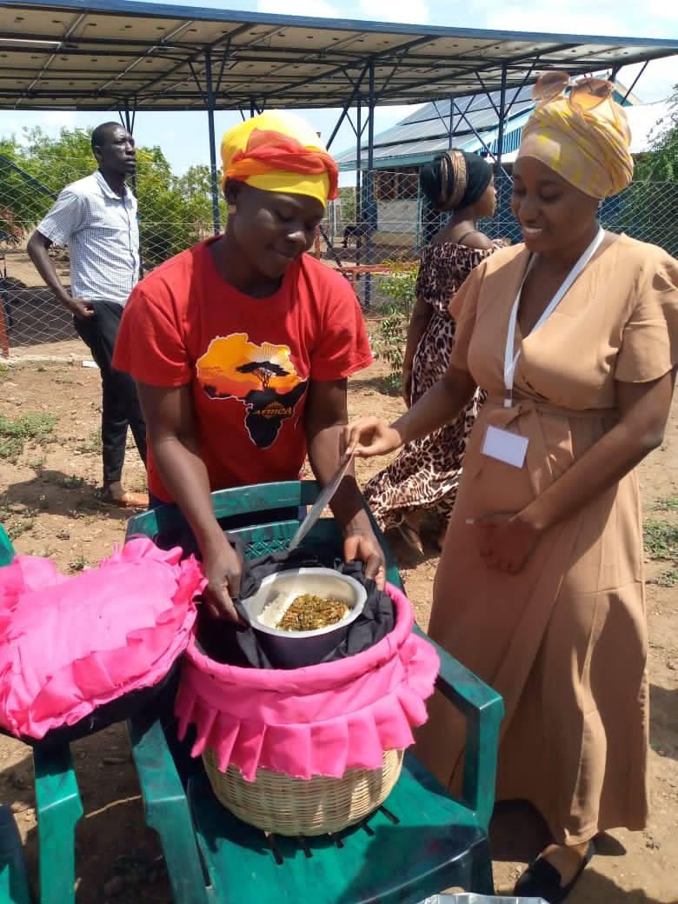
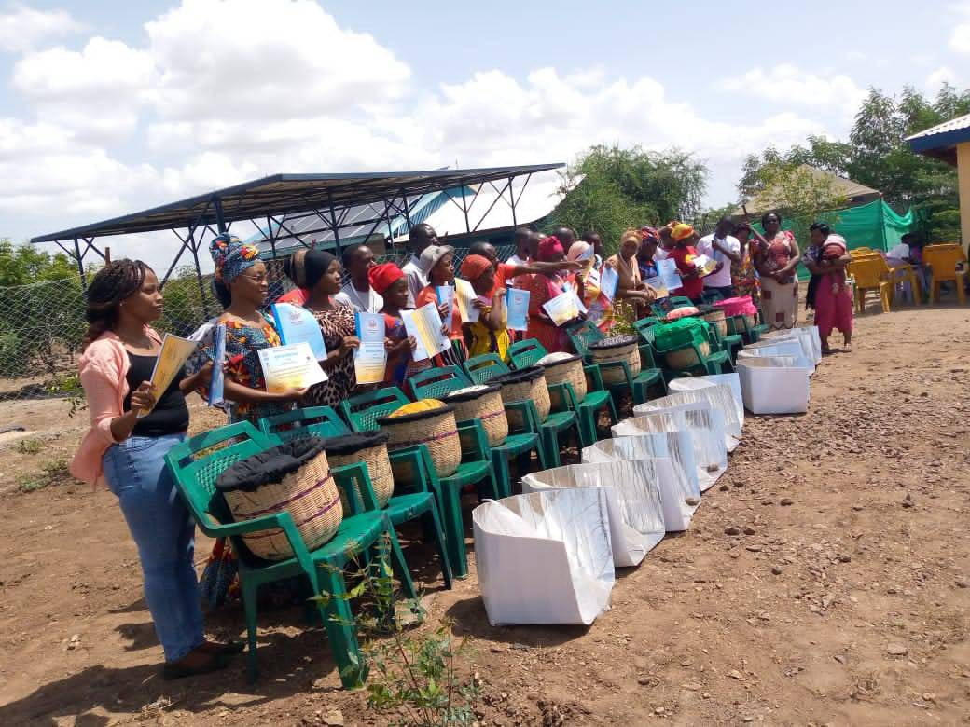
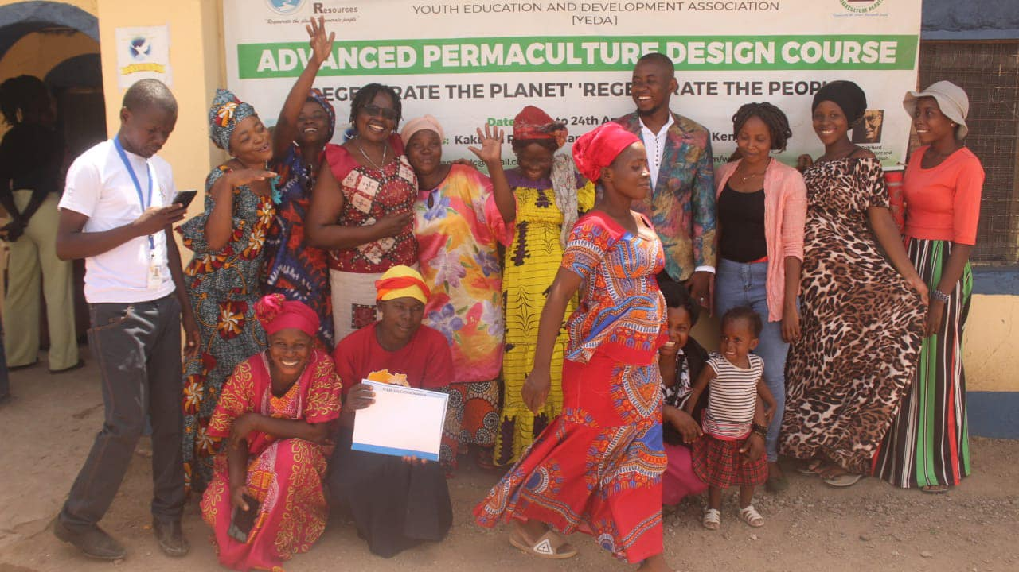
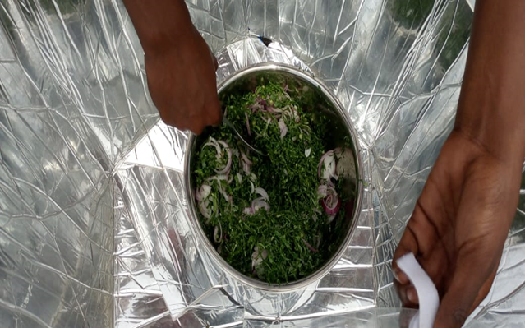
Trainer Graduation Celebration
Notes:
Day 10 was a special graduation ceremony. Each attendee received a certificate of completion, invited their family and friends and local dignitaries. The 11 trainees cooked the food in the Haines 1 Pop Open Oven and enjoyed a delicious “show what you know” style close to the program. The WhatsApp group included 11 trainees and 4 supporters and solar cooking experts for continued support. Messages were read from supporters with project involvement.

Slide 9
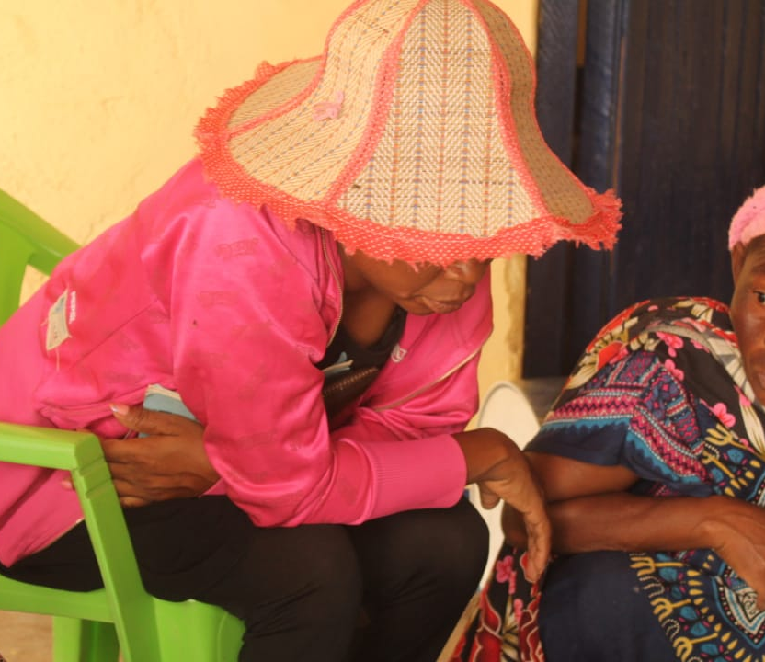
Follow Up Program
Support Group
Data Tracking
Post Survey
Education
Demonstrations
Entrepreneurship
Growth
IMPACT
Notes:
Follow up is a critical part of the aftercare of any program. Trainees are supported through access to expert solar cooks, and the Haines oven creator. Data sheets are included in the trainee's workbook and cooking data is collected through the whats app group. For those without smart phones, the YEDA manager will collect data weekly and photos to contribute to the group. Support is the key to success and will continue as long as there is trainee interest

Slide 10
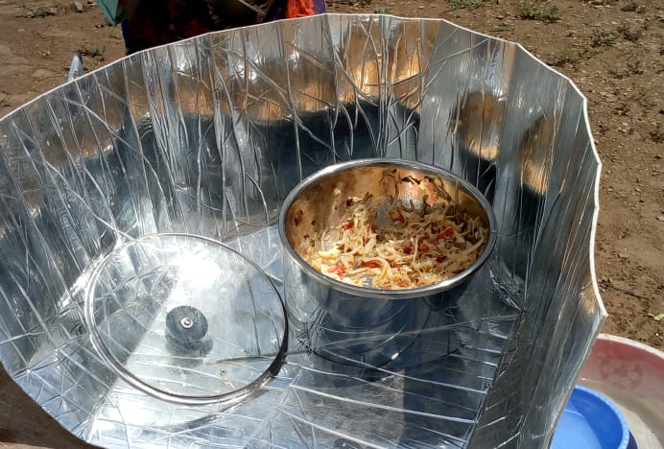
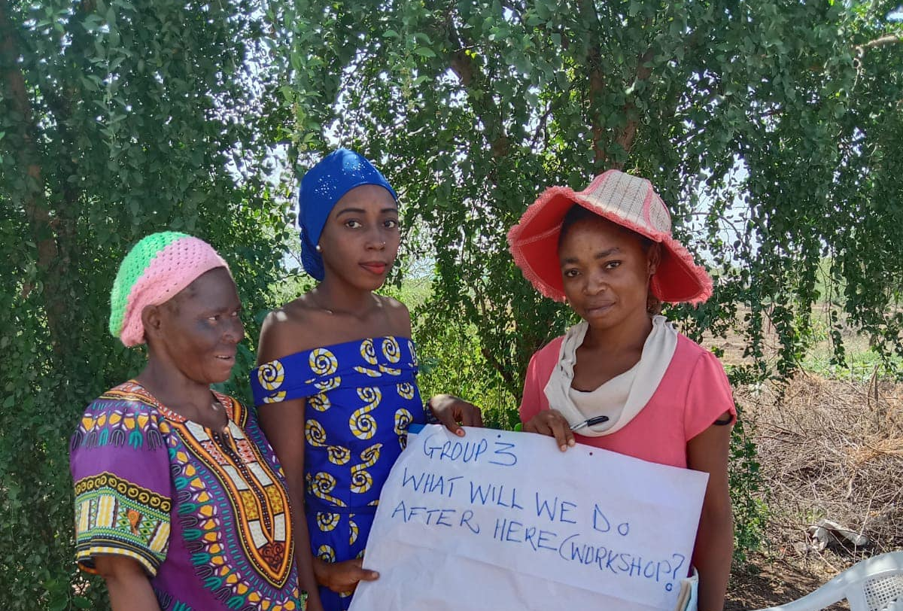
Entrepreneurship Opportunity
Notes:
Materials for making the Haines 1 pop open oven were offered to the facilitators (Grace, Camily and Bruno) and the YEDA group CEO (Rhamadhani). Each distribution discussed the entrepreneurship opportunities in their regions of Eldoret and Kakuma. Each of the benefactors will work with Roger Haines to develop a plan to make and sell solar cookers, utilizing the field training manual to continue the continuity. The cook pot, lid and basket are not included. One group was successful in painting a pot black for the workshop and lide are available locally.

Slide 11
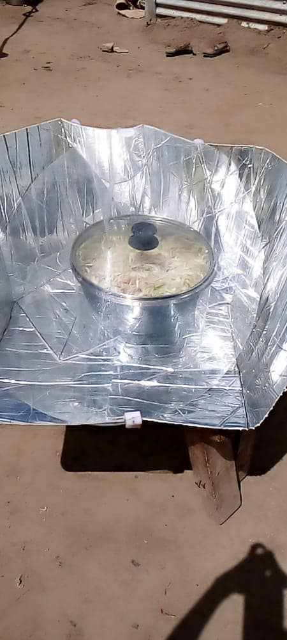
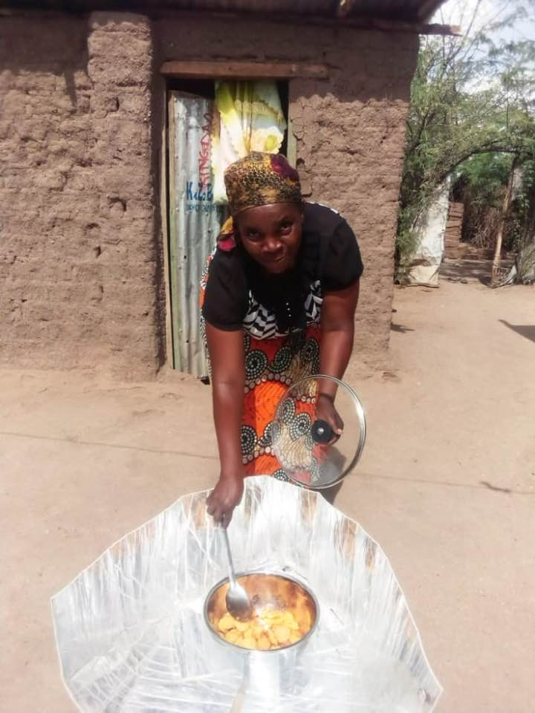
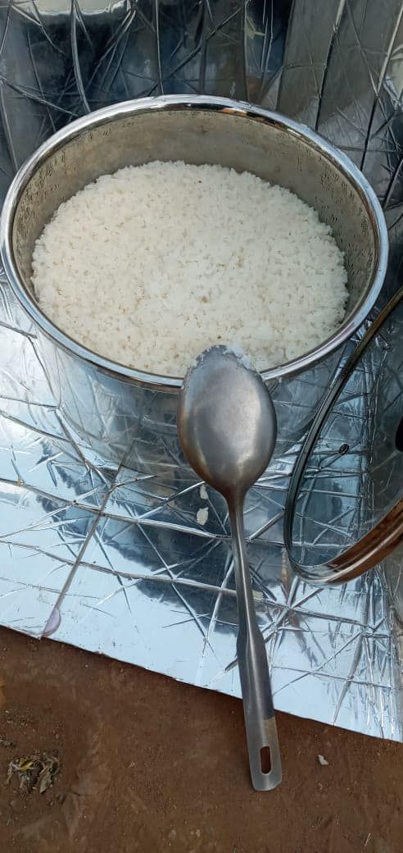
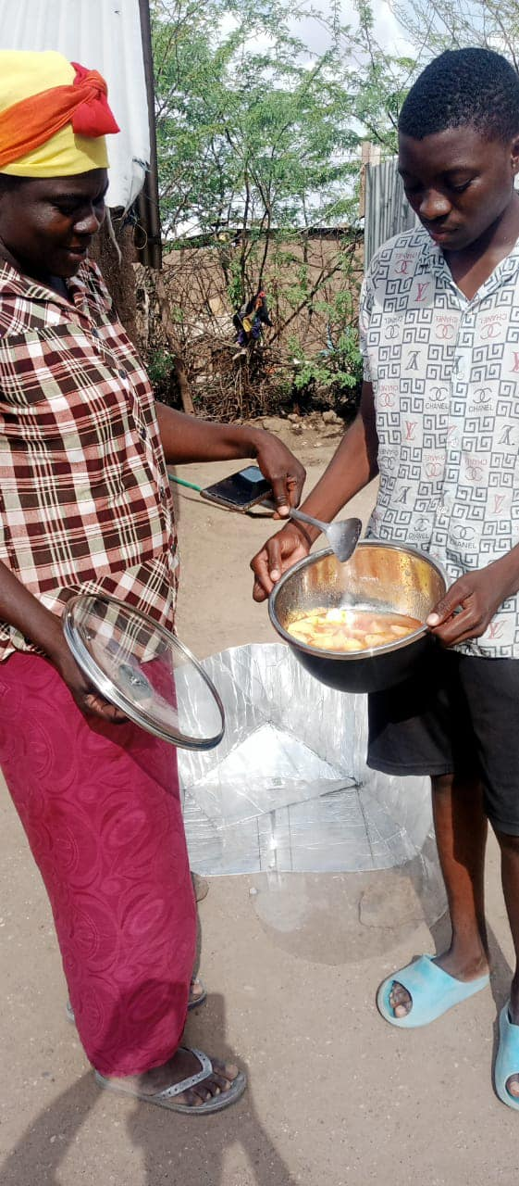
Build Relationships that Cultivate Trust using Whats App
Participants cook at home and share their experiences with the WhatsApp group. Photos, data, comments, questions, & encouragement are all part of building community.
Notes:
Resist the sense of over urgency to determine a project’s success. Support is a key aspect to long term project success and sustainability, and it is gathered when a large number of trainees participate. All trainees registered and all of the trainers, stakeholders and supporters joined the group. Pictures, videos and regular updates are received from the group. The women are proud to share their cooking and new skills.

Slide 12
Cooking Data: Collected via Whats App Support Group

Slide 14
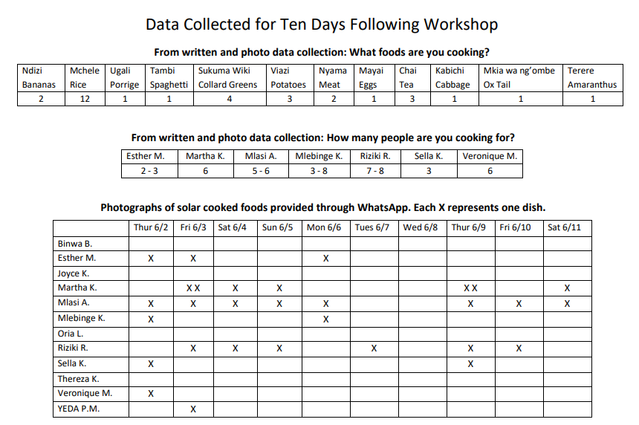

Slide 15
SCI Baseline Survey
Notes:
SCI Baseline Survey essential questions were answered by all participants. SEP will continue to communicate with this group and conduct a the follow up survey in six months.

Slide 16
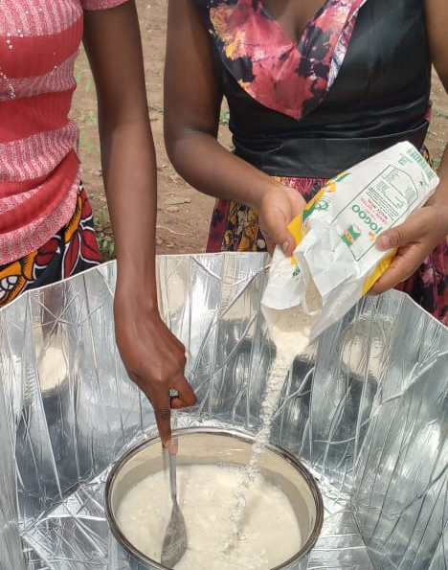
Feedback and Recommendations
Cultivate communication and reporting in key priority areas
Balance time, effort and costs
Determine impact indicators
Assess trainee interest
Create materials in most useful language
Clearly identify action areas
Surveys
Follow up
Designated Daily Reporter
Notes:
This section is the hardest to assess, immediately following the workshop. A support program for trainee success is in place, the women are reporting and taking photos of their cooking. Step 1 of the follow up is successful. Those without a smart phone are able to report their result to the YEDA Office Manager. Updates will be given at the 6 month and 1 year mark. The focus group style field training was well organized and programmatically sound. The facilitators were well qualified, long-term solar cooking and hear retention basket educators with workshop experience in Kenya. However, the language barrier was a problem on occasion. The refugees spoke different dialects of Swahili, and the facilitators interpreted content for better understanding; therefore, the pace of the workshop was altered.

Slide 17
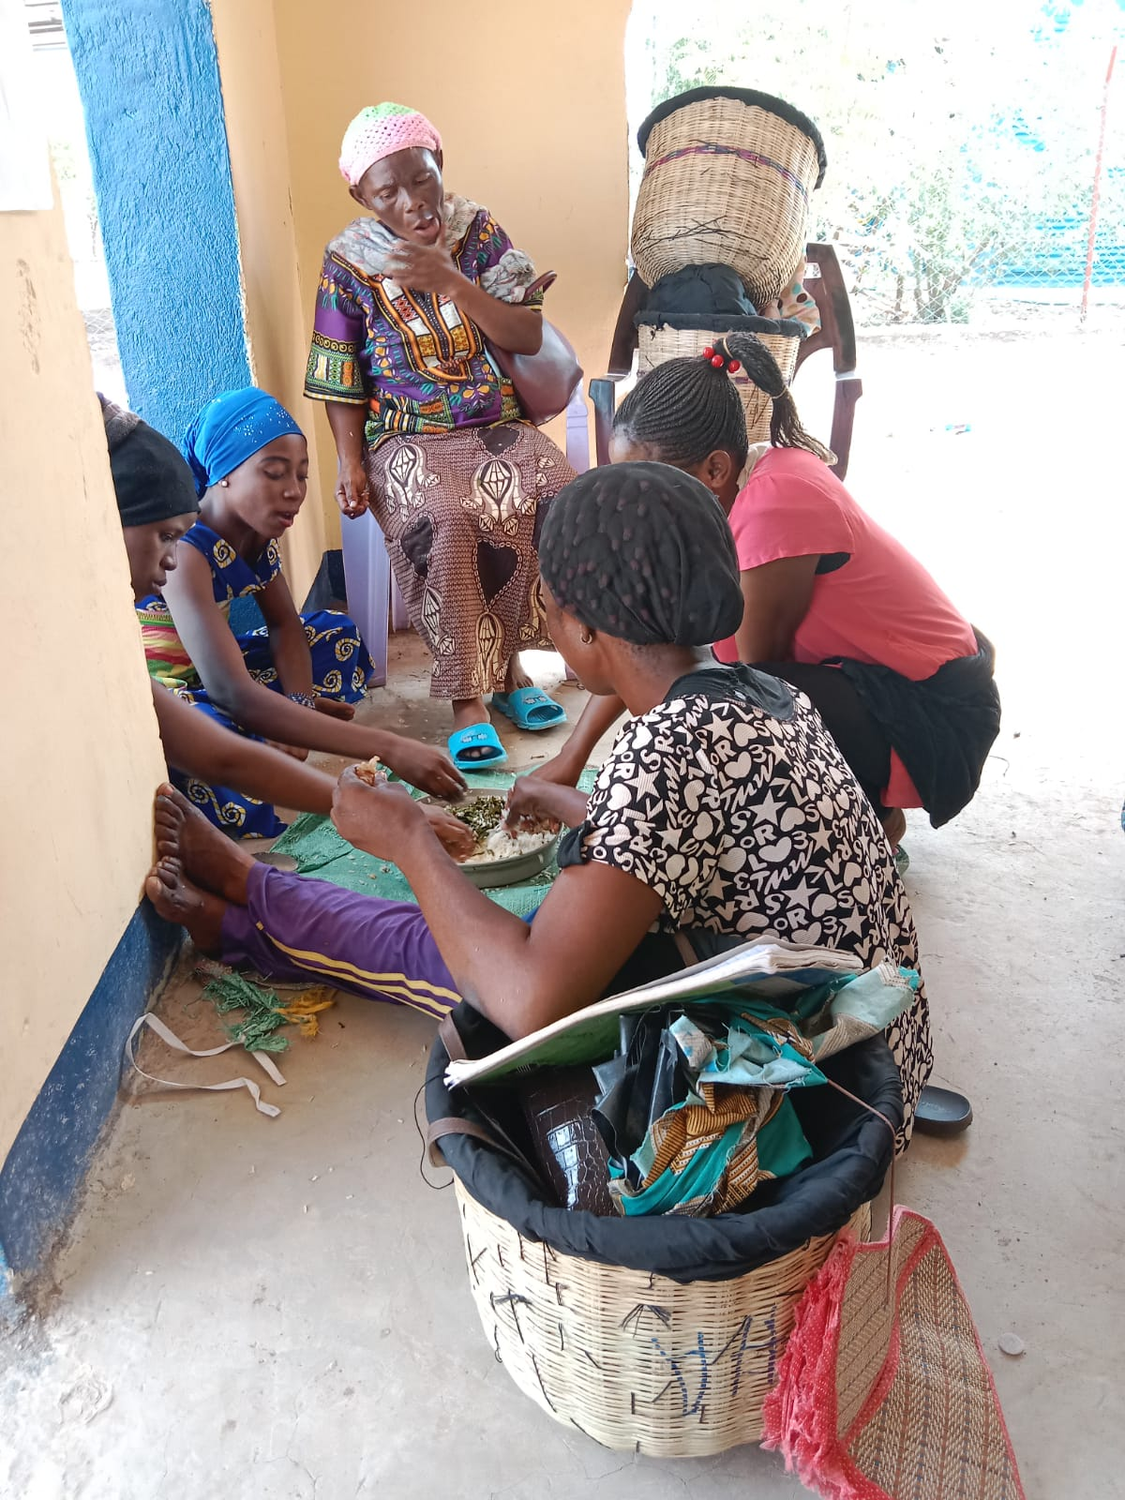
Future Plans
Develop relationships with trainers to cultivate an environment of support
Reimagine cooking education in a way that is culturally responsive, renewable, sustainable and contributes to a healthy lifestyle
Promote solar cooking and integrated cooking solutions that use locally sourced materials, foods, support the local economy and foster independence from cooking with charcoal and wood
Notes:
The 2nd Haines Focus Group Workshop is taking place in Dadaab June 13th – 23rd with Adieu as the facilitator. Adieu spent 4 days observing the Kakuma Focus Group and was able to learn the steps to basket making, firsthand. The workbooks and trainee manuals were emailed to her for printing and review. There should be an organizational consistency with the 2 projects to implement the best practices model for field training.

Slide 18
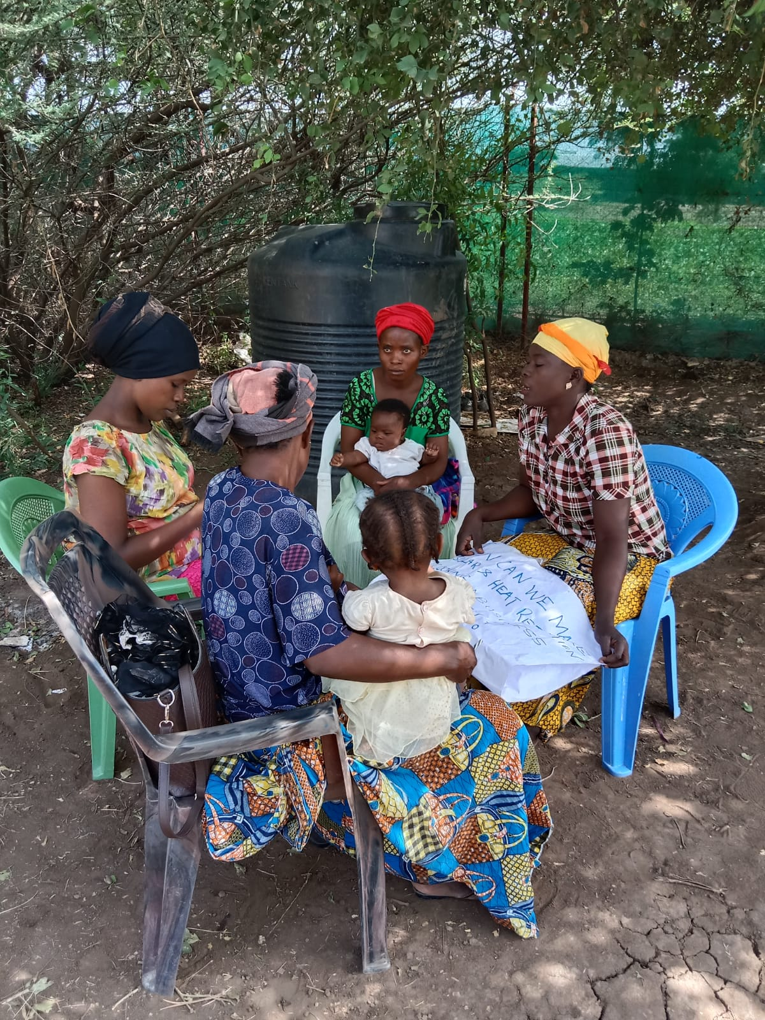
Thank You
Gdsnonprofit.com
solareducationproject@gmail.com
@ solareducationproject
Notes:
Thank you to our partners and supporters for your commitment and dedication to a successful program. Roger Haines and the pop open cooker have successfully trained 11 women from the Kakuma 3 refugee camp. SEP is an education and advocacy group, dedicated to the successful transfer of information to increase the use of the sun’s free, renewable energy for cooking food.

